Slide 1

Blog App/Website
Translated from Turkish to English - www.onlinedoctranslator.com

Slide 2
Basic Information and Purpose of the Application
The "Web Design and Responsive Blog App/Website with Admin Panel" project is a key accomplishment during your internship. In this project, you developed a blog platform using PHP, MySQL, HTML, CSS, and JavaScript, incorporating responsive design principles.
Users can read blogs, filter them by categories, and use the search feature to find specific content. At the same time, users can register as writers, add their own posts, edit them, and delete them as needed.
Administrators have the authority to manage all content on the platform. They can edit, delete, and manage categories effectively.
Through this project, you strengthened your software development skills and provided an interactive blog experience tailored to user needs.

Slide 3
Basic Information and Purpose of the Application
Using HTML, CSS, JavaScript, PHP, and MySQL for web design, the goal is to create and develop a website or application based on these core components. HTML defines the page structure; CSS controls the visual style and layout; JavaScript adds interactivity; PHP creates dynamic web pages; and MySQL handles database management.

Slide 4
Basic Information and Purpose of the Application
Project Purpose: The main aim is to create an interactive blog platform.
Project Results:
A blog website/app designed with responsive design principles.
A user-friendly interface with interactive features.
Personal accounts and profiles for users.
A special panel for authors to add, arrange, and delete their writings.
Executive authority for administrators to manage all content.

Slide 5
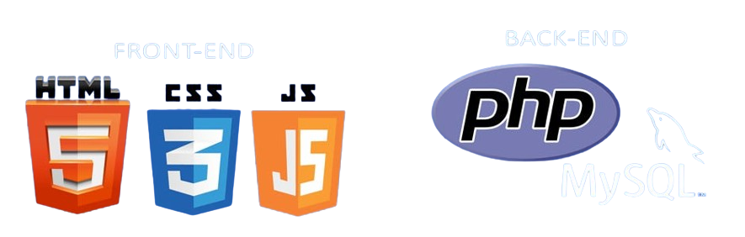
Basic Information and Purpose of the Application

Slide 6
Basic Information and Purpose of the Application
Software Development Details:
Used Software Architecture: MVC (Model-View-Controller)
Data Storage Environment: MySQL Database
Interactive Features: JavaScript was used to provide interactivity
Responsive Design: CSS Media Queries were utilized for responsive design

Slide 7
Basic Information and Purpose of the Application
Made Works and Tasks:
Design and development of the blog platform
Creation of user and writer panels
Development of the executive control panel
Database design and management

Slide 8
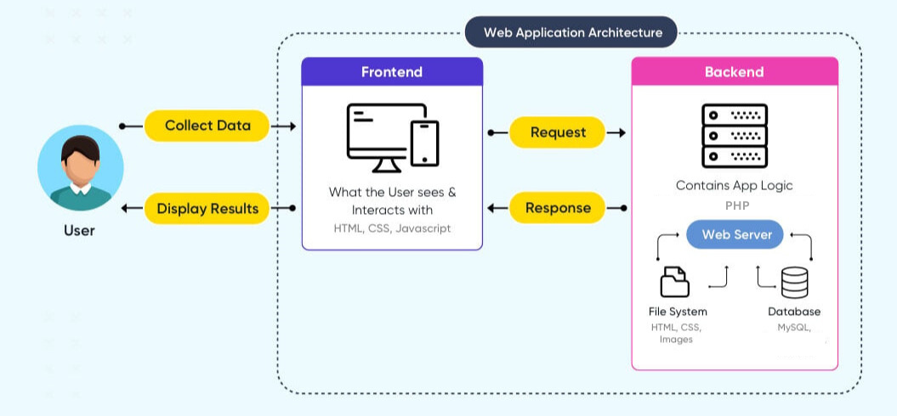
Architecture and Technical Specifications of the Application

Slide 9
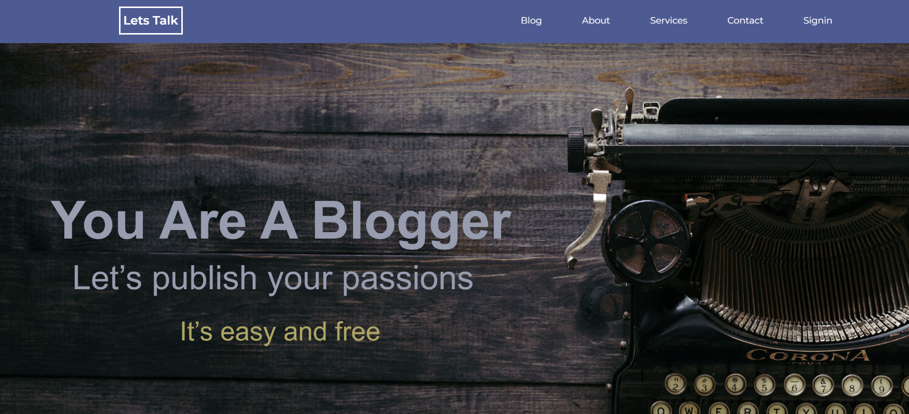
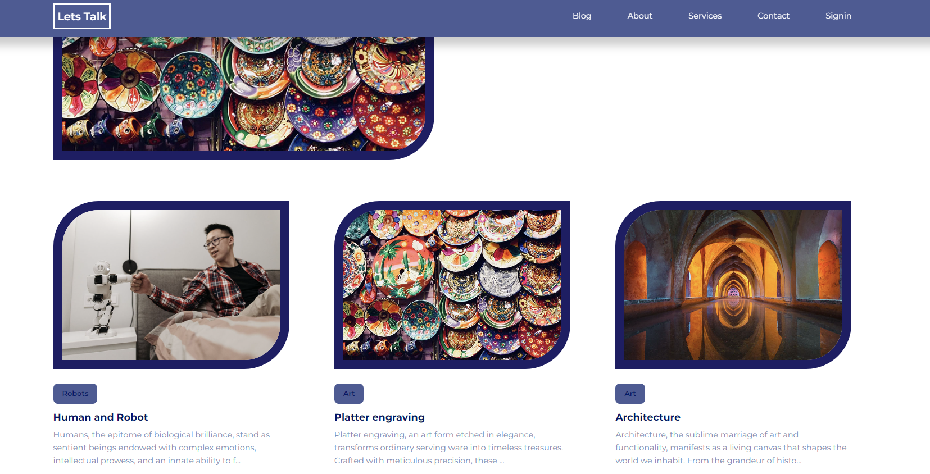
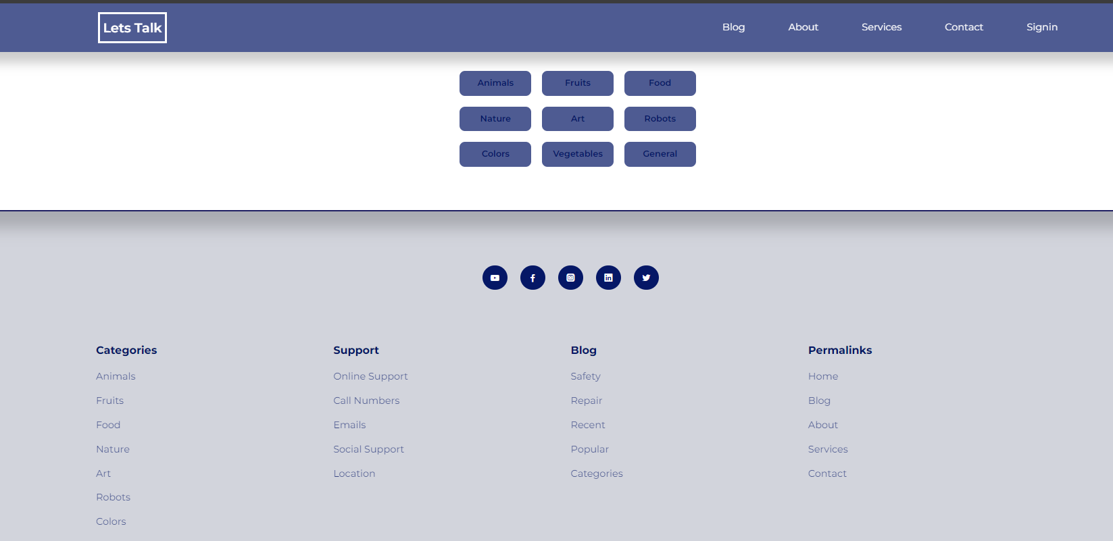
Information on the Operation and Use of the Application

Slide 10
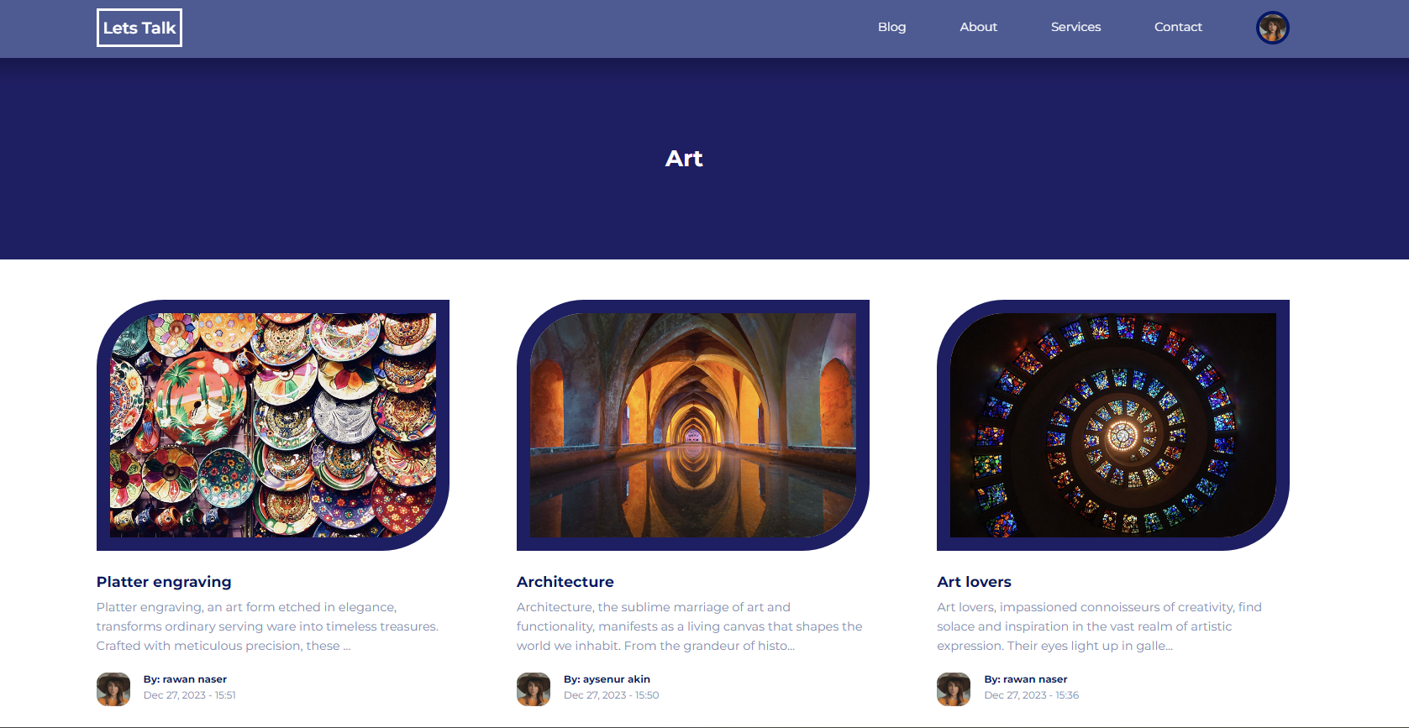
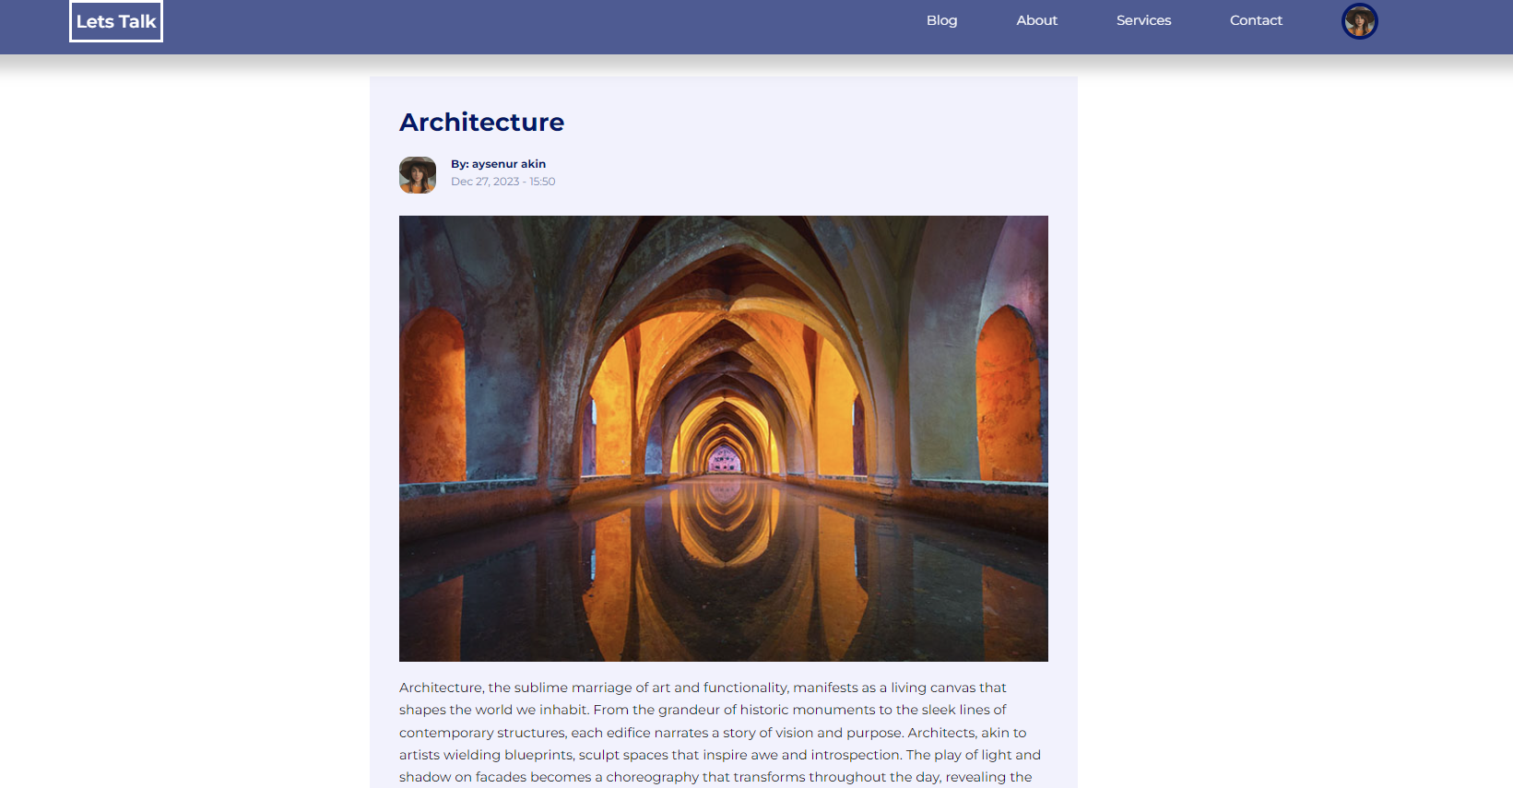
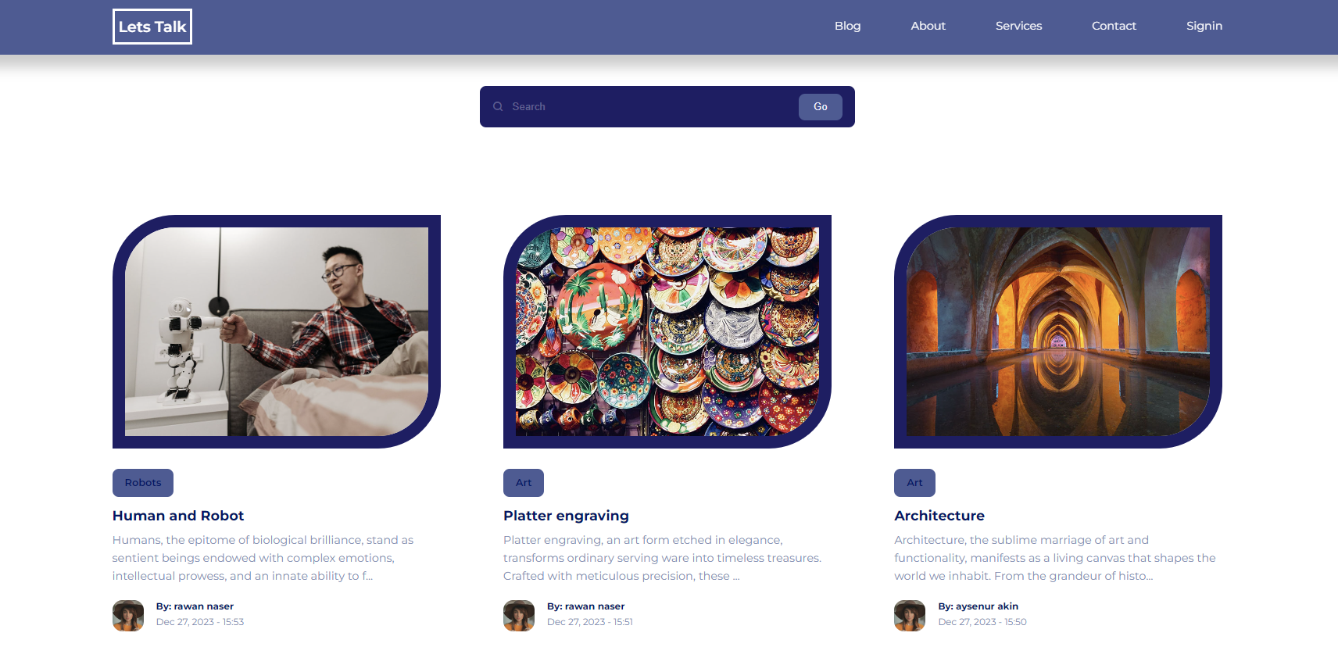
Information on the Operation and Use of the Application

Slide 11
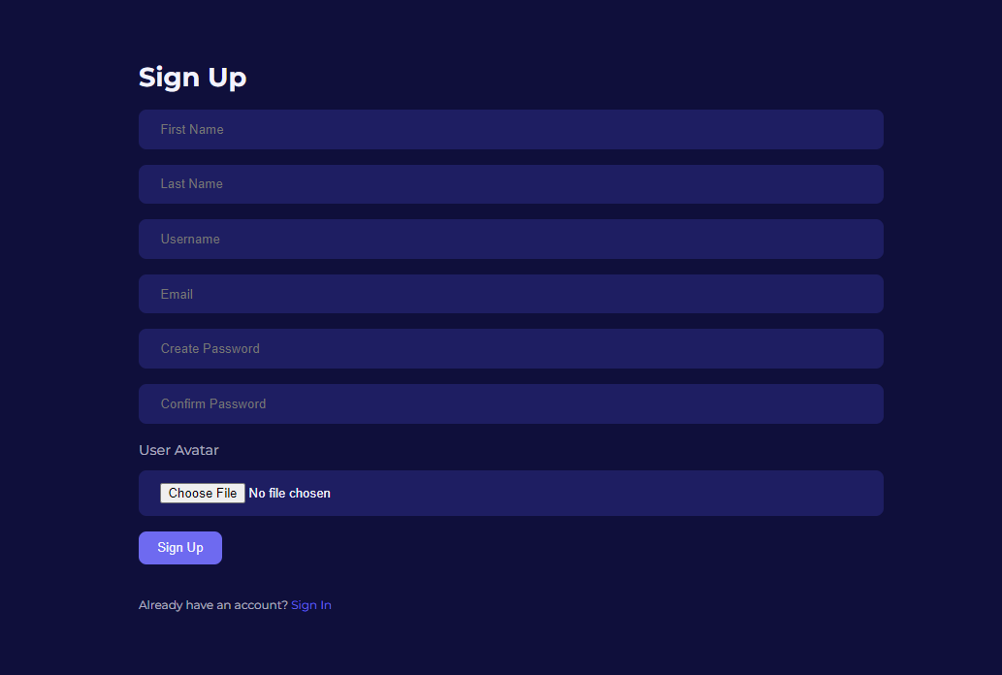
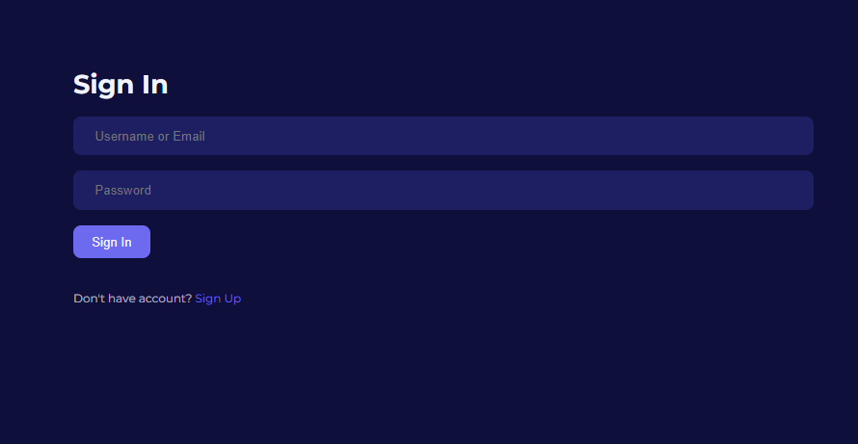
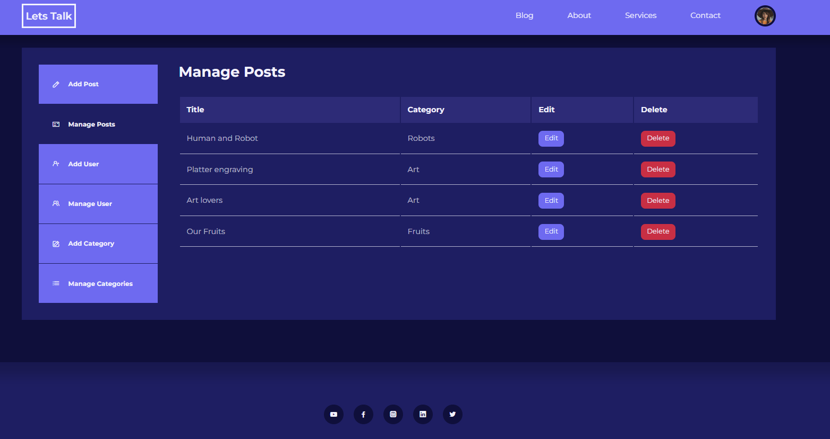
Information on the Operation and Use of the Application

Slide 12
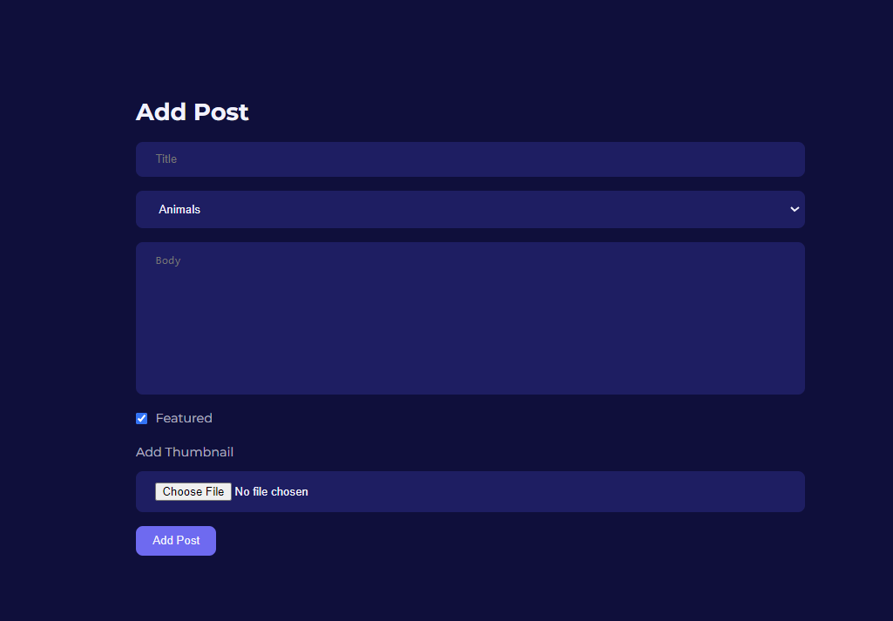
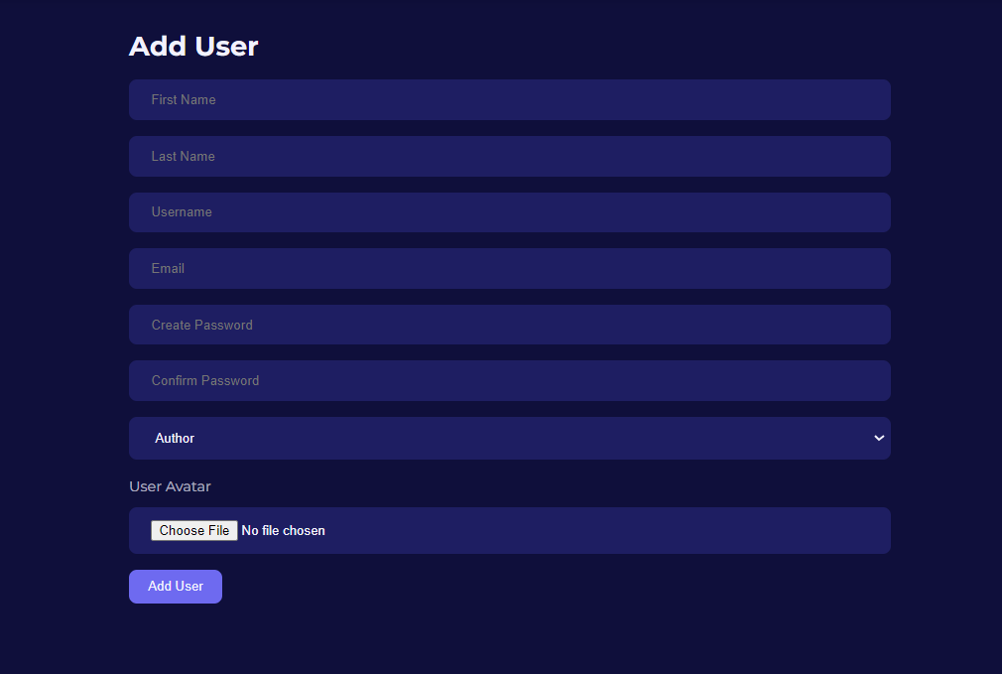
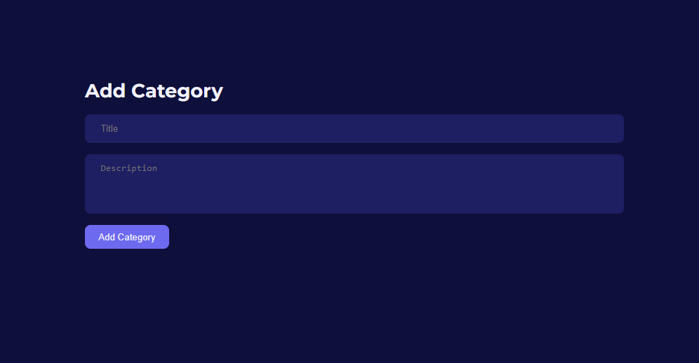
Information on the Operation and Use of the Application

Slide 13
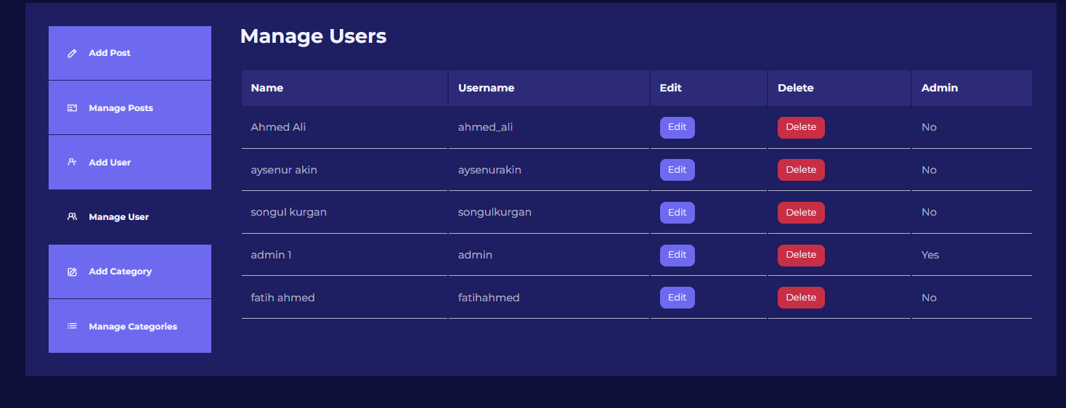
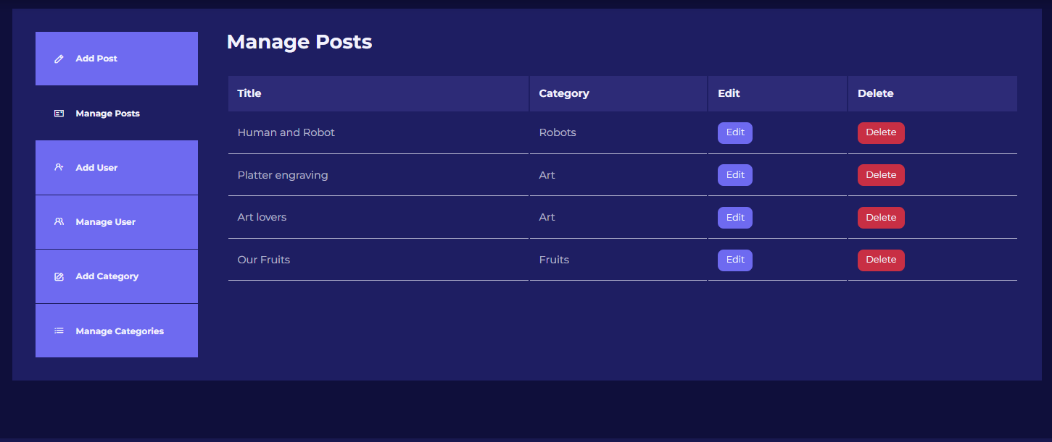
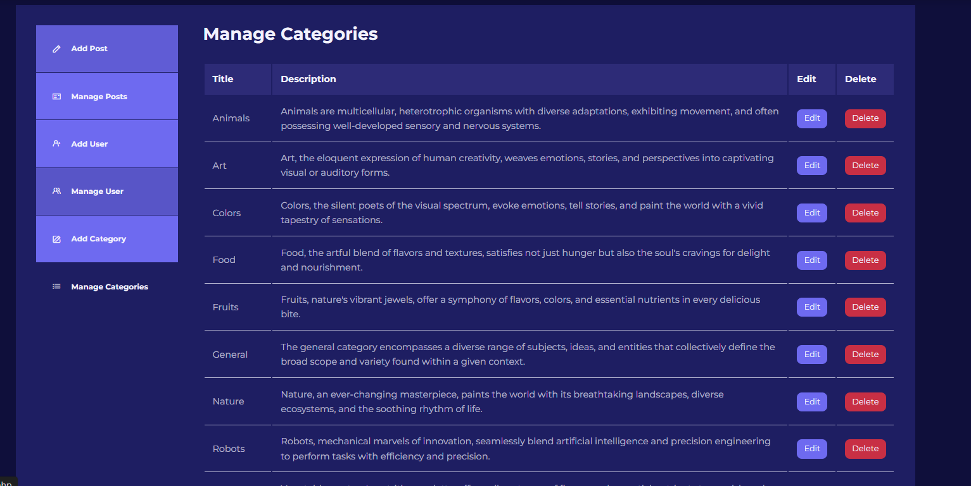
Information on the Operation and Use of the Application

Slide 14
THANKS

